Slide 1



BANK OF CLI
Manasi Menon

Slide 2
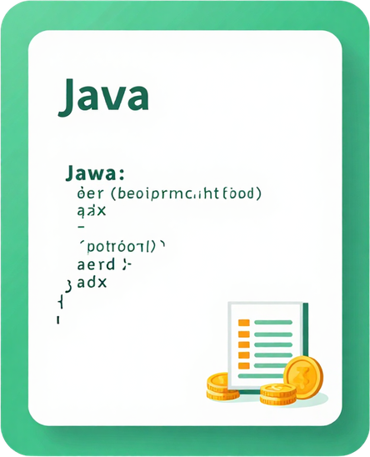
Bank of CLI is a command-line banking application built in Java that simulates core banking operations. Users can register an account, log in using an Account ID and PIN, check their balance, deposit and withdraw funds, transfer money, and view transaction history.
Project Overview
The application uses PostgreSQL for persistent data storage, JDBC for database communication, and a layered architecture that separates the CLI, business logic, and database operations. PostgreSQL runs locally through Docker.

Slide 3

Key Features
Account Registration & Login
Account ID with 4-digit PIN validation
Balance Management
Check balance, deposit, and withdraw funds
Secure Transfer Logic
Transfer funds while preventing overdrafts
Transaction History
Store and retrieve recent account transactions
Logging & Error Handling
Track successful actions and application failures

Slide 4
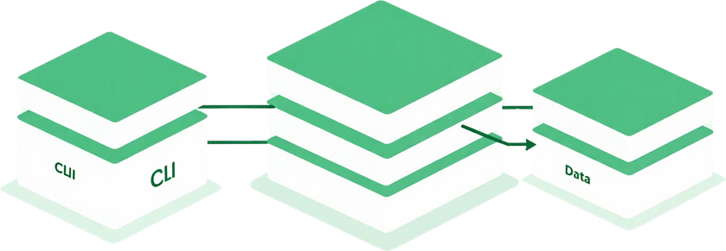
Architecture Overview
API Layer
Handles terminal menus, Scanner input, user prompts, and output. It communicates only with the service layer.
Service Layer
Contains banking rules such as PIN validation, insufficient-funds checks, deposits, withdrawals, transfers, and transaction handling.
Repository Layer
Uses JDBC and SQL to communicate with PostgreSQL and convert database rows into Java objects.
User → BankCli → BankService → Repository → JDBC → PostgreSQL

Slide 5
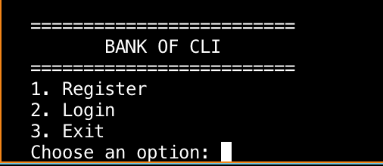
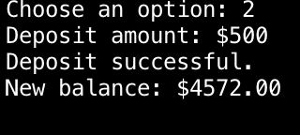


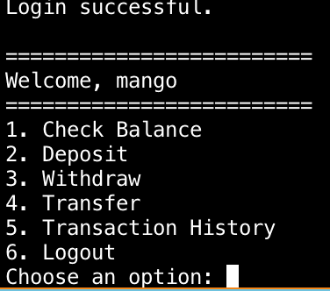
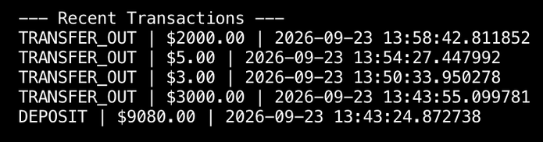
Application Demo

Slide 6

















TECHNOLOGY STACK
Java 21
PostgreSQL + Docker
Maven
JDBC
JUnit 5 + Mockito
SLF4J + Logback
Git + GitHub

Slide 7


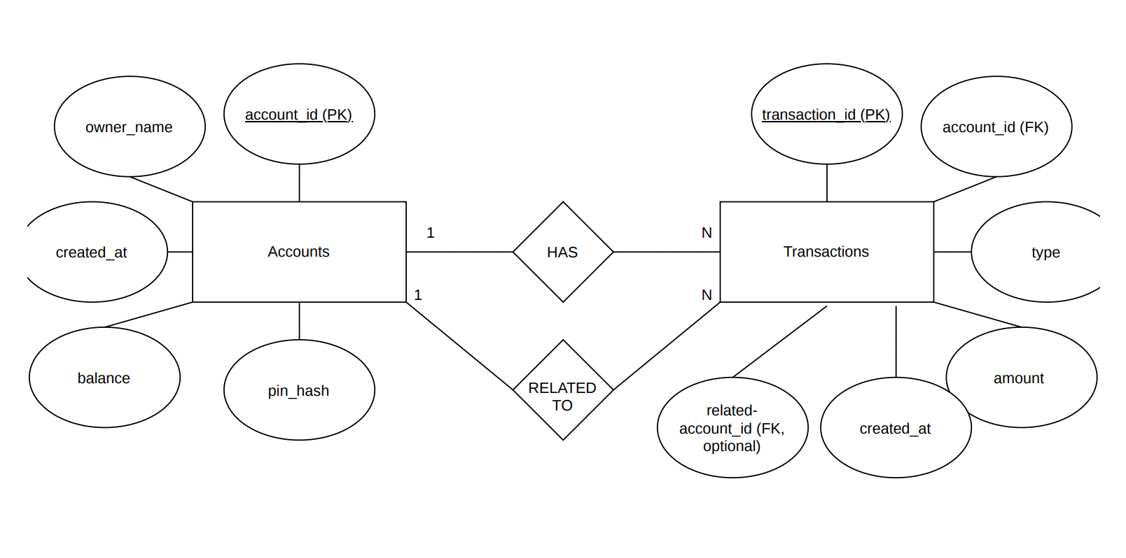


ENTITY RELATIONSHIP OVERVIEW

Slide 8

Bank of CLI demonstrates how Java, JDBC, PostgreSQL, and layered architecture can be combined to create a complete command-line banking application. The project supports account registration, authentication, balance management, transfers, transaction history, logging, and structured error handling.
Conclusion
What I Learned
• Building a layered Java application
• Connecting Java to PostgreSQL with JDBC
• Managing database transactions and rollbacks
• Implementing custom exceptions and logging
• Writing positive and negative JUnit tests

Slide 9
Thank You!

